Slide 1
CSE 440
Artificial Intelligence
Propositional Logic
Dr. Mohammad Mahmudul Alam
Department of Electrical & Computer Engineering (ECE)
North South University (NSU)

Slide 2
Last Time
Intelligent agents need knowledge about the world for making good decisions.
The knowledge of an agent is stored in knowledge base (KB) in the form of sentences in a knowledge representation language.
A knowledge-based agent needs a knowledge base (KB) and an inference mechanism.
It operates by storing sentences in its knowledge base, inferring new sentences with the inference mechanism and using them to deduce which actions to take.
A representation language is defined by its syntax and semantics, which specify structure of sentences and how they relate to world facts.
The interpretation of a sentence is the fact to which it refers. If this fact is part of the actual world, then the sentence is true.

Slide 3
Propositional Logic
A simple language consisting of propositional symbols and logical connectives.
Symbols, like P and Q are defined with their semantics.
Propositional symbols combined using logical connectives yield logical expressions.

Slide 4
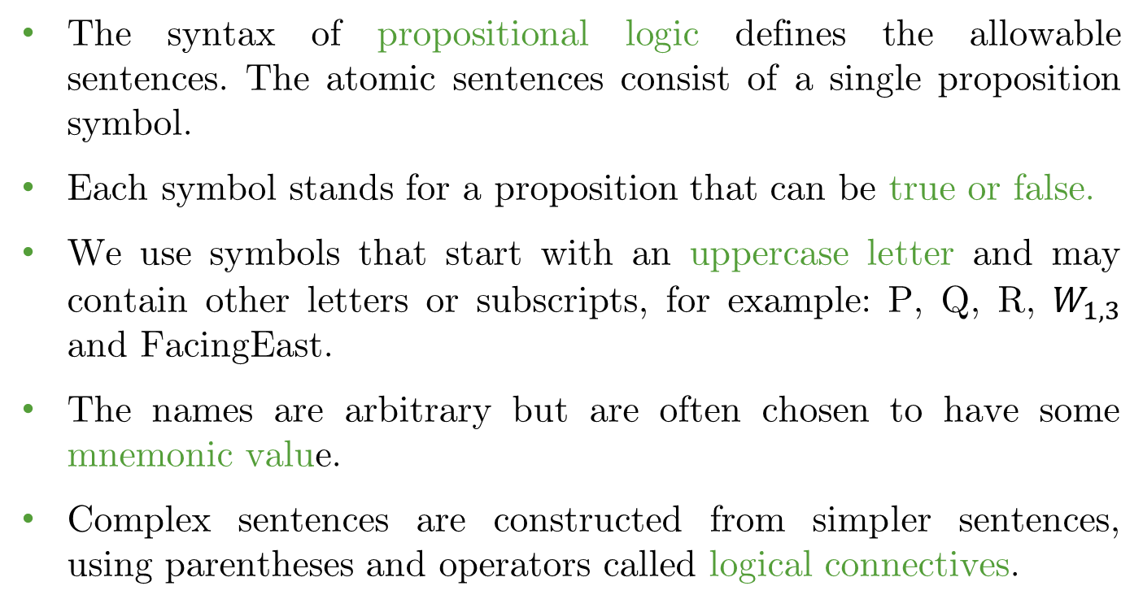
Syntax
The syntax of propositional logic defines the allowable sentences. The atomic sentences consist of a single proposition symbol.
Each symbol stands for a proposition that can be true or false.
We use symbols that start with an uppercase letter and may contain other letters or subscripts, for example: P, Q, R, $W_{1,3}$ and FacingEast.
The names are arbitrary but are often chosen to have some mnemonic value.
Complex sentences are constructed from simpler sentences, using parentheses and operators called logical connectives.

Slide 5
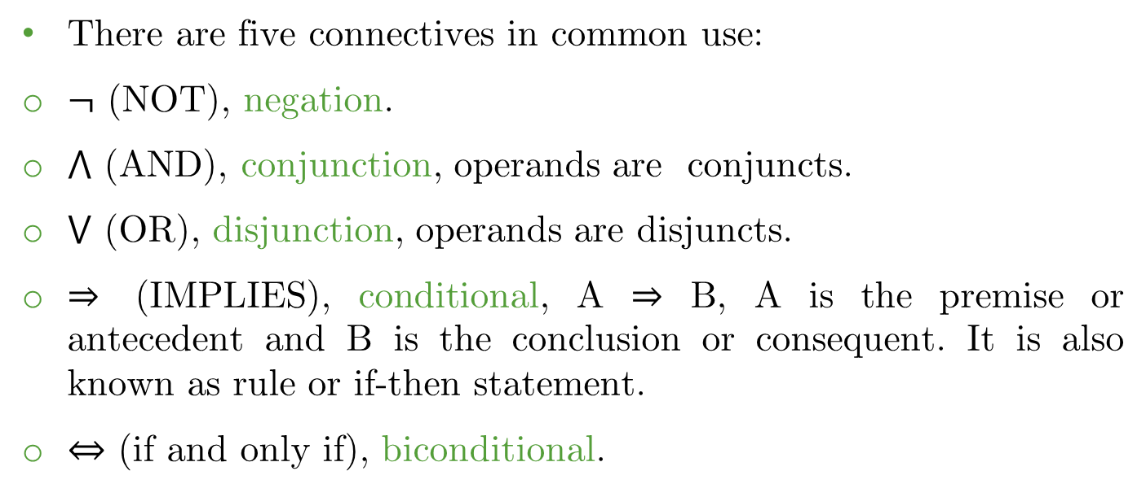
Syntax
There are five connectives in common use:
$¬$ (NOT), negation.
$⋀$ (AND), conjunction, operands are conjuncts.
$⋁$ (OR), disjunction, operands are disjuncts.
$⇒$ (IMPLIES), conditional, A ⇒ B, A is the premise or antecedent and B is the conclusion or consequent. It is also known as rule or if-then statement.
$⇔$ (if and only if), biconditional.

Slide 6
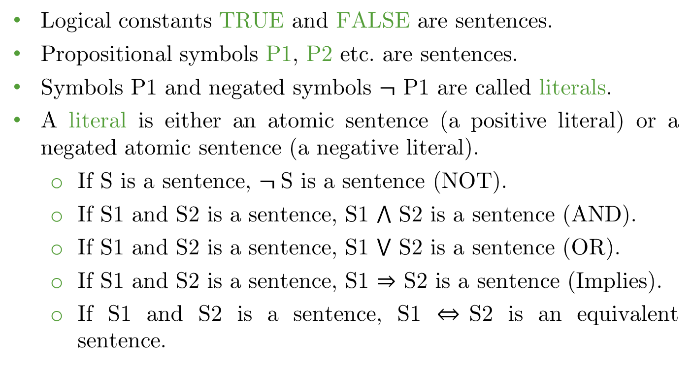
Syntax
Logical constants TRUE and FALSE are sentences.
Propositional symbols P1, P2 etc. are sentences.
Symbols P1 and negated symbols $¬$ P1 are called literals.
A literal is either an atomic sentence (a positive literal) or a negated atomic sentence (a negative literal).
If S is a sentence, $¬$S is a sentence (NOT).
If S1 and S2 is a sentence, S1 $⋀$ S2 is a sentence (AND).
If S1 and S2 is a sentence, S1 $⋁$ S2 is a sentence (OR).
If S1 and S2 is a sentence, S1 $⇒$ S2 is a sentence (Implies).
If S1 and S2 is a sentence, S1 $⇔$S2 is an equivalent sentence.

Slide 7
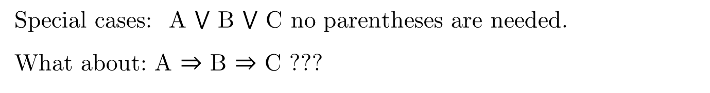
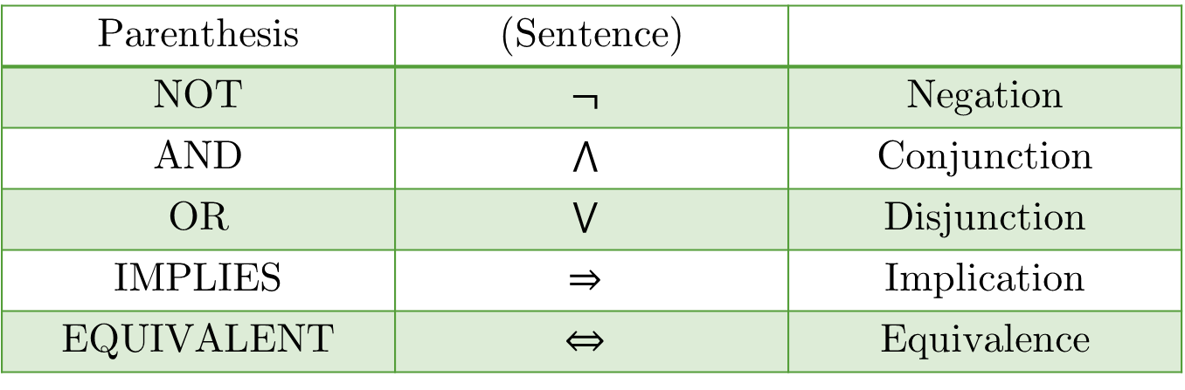
Knoweldge Representation & Reasoning
Precedence Order
From higher to lower:
Parenthesis | (Sentence)
NOT | $$¬$$ | Negation
AND | $$⋀$$ | Conjunction
OR | $$⋁$$ | Disjunction
IMPLIES | $$⇒$$ | Implication
EQUIVALENT | $$⇔$$ | Equivalence
Special cases: A $⋁$ B $⋁$ C no parentheses are needed.
What about: A $⇒$ B $⇒$ C ???

Slide 8
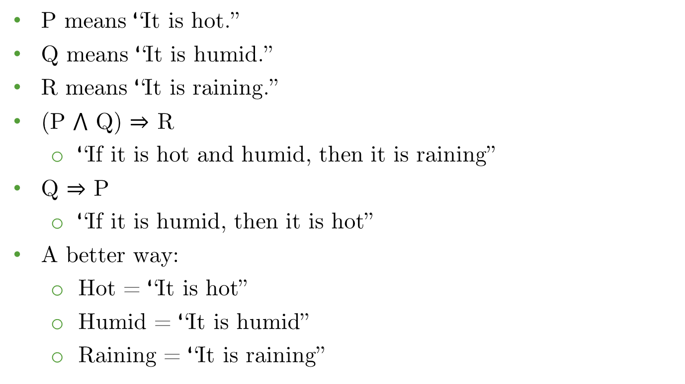
Example
P means “It is hot.”
Q means “It is humid.”
R means “It is raining.”
(P $⋀$ Q) $⇒$ R
“If it is hot and humid, then it is raining”
Q $⇒$ P
“If it is humid, then it is hot”
A better way:
Hot = “It is hot”
Humid = “It is humid”
Raining = “It is raining”

Slide 9
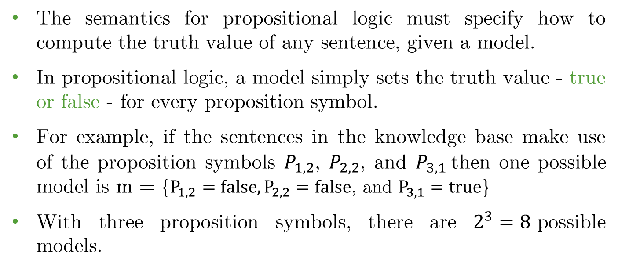
Semantic
The semantics for propositional logic must specify how to compute the truth value of any sentence, given a model.
In propositional logic, a model simply sets the truth value - true or false - for every proposition symbol.
For example, if the sentences in the knowledge base make use of the proposition symbols $P_{1, 2}$, $P_{2, 2}$, and $P_{3, 1}$then one possible model is m = {$P_{1, 2}=false, P_{2, 2}=false\text{, }\text{and} P_{3, 1}=true$}
With three proposition symbols, there are $2^{3}=8$possible models.

Slide 10
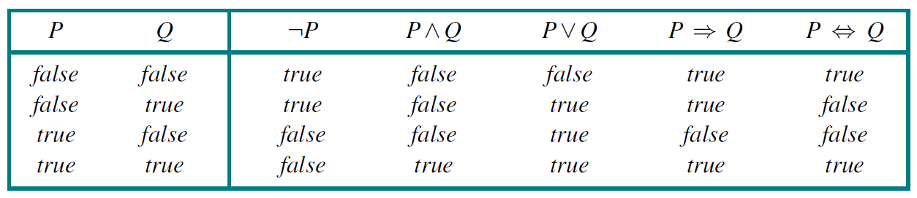
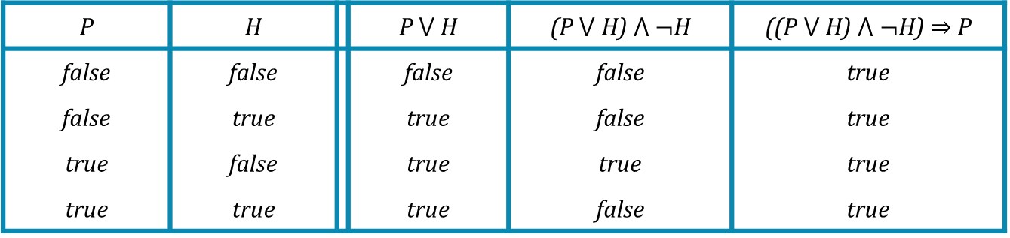
Truth Table
Truth table for five logical connectives:
A complex sentence: ((P $⋁$ H) $⋀$ $¬$H) $⇒$ P
P | H |  | P $⋁$ H | (P $⋁$ H) $⋀$ $¬$H | ((P $⋁$ H) $⋀$ $¬$H) $⇒$ P
false | false |  | false | false | true
false | true |  | true | false | true
true | false |  | true | true | true
true | true |  | true | false | true

Slide 11
Inference
Inference is the process of deriving new sentences from old ones.
Given a Knowledge Base (KB) and query 𝛼 we check:
Does KB╞ 𝛼 ? How can we proof?
Methods:
Enumeration Method (both sound and complete)
Inference Rules (sound, but not complete)
If clauses are in Conjunctive Normal Form (CNF)
Resolution (both sound and complete)
If clauses are in Horn Form
Forward Chaining (both sound and complete)
Backward Chaining (both sound and complete)

Slide 12
Enumeration Method (Model Checking)
Let 𝛼 = A ⋁ B and KB = (A ⋁ C) ⋀ (B ⋁ ¬C)
Is it the case that KB╞ 𝛼 ?
Check all possible models where 𝛼 must be whenever KB is true.
A | B | C | KB (Α ∨ C) ∧ (B ∨ ¬C) | α = Α ∨ Β
False | False | False | False | False
False | False | True | False | False
False | True | False | False | True
False | True | True | True | True
True | False | False | True | True
True | False | True | False | True
True | True | False | True | True
True | True | True | True | True

Slide 13
Enumeration Method
KB╞ α
A | B | C | KB (Α ∨ C) ∧ (B ∨ ¬C) | α = Α ∨ Β
False | False | False | False | False
False | False | True | False | False
False | True | False | False | True
False | True | True | True | True
True | False | False | True | True
True | False | True | False | True
True | True | False | True | True
True | True | True | True | True

Slide 14
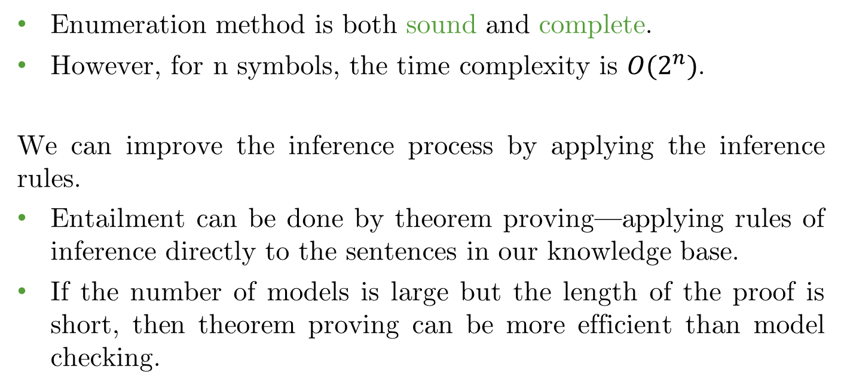
Enumeration Method
Enumeration method is both sound and complete.
However, for n symbols, the time complexity is $O(2^{n})$.
We can improve the inference process by applying the inference rules.
Entailment can be done by theorem proving—applying rules of inference directly to the sentences in our knowledge base.
If the number of models is large but the length of the proof is short, then theorem proving can be more efficient than model checking.

Slide 15
Validity and Satisfiability
Before we diving into the theorem-proving algorithms, we will need some concepts related to entailment.
A sentence is valid, if it is true in all models, e.g., True, A ⋁ ¬A, A ⇒ A, (A ⋀ (A ⇒ B)) ⇒ B
Validity is connected to inference via the Deduction Theorem: KB ╞ α if and only if (KB ⋀ α) is valid.
A sentence is satisfiable if it is true in some model, e.g., A ⋁ B
A sentence is unsatisfiable if it is false in all models. e.g., A ⋀ ¬A
Satisfiability is connected to inference via the following:
KB ╞ α if and only if (KB ⋀ ¬α) is unsatisfiable (there is no model for which KB = true and α is false).

Slide 16
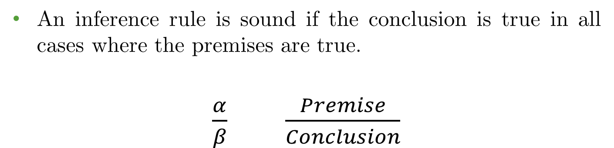
Propositional Logic: Inference Rules
An inference rule is sound if the conclusion is true in all cases where the premises are true.
$\frac{α}{β}$ $\frac{Premise}{Conclusion}$

Slide 17
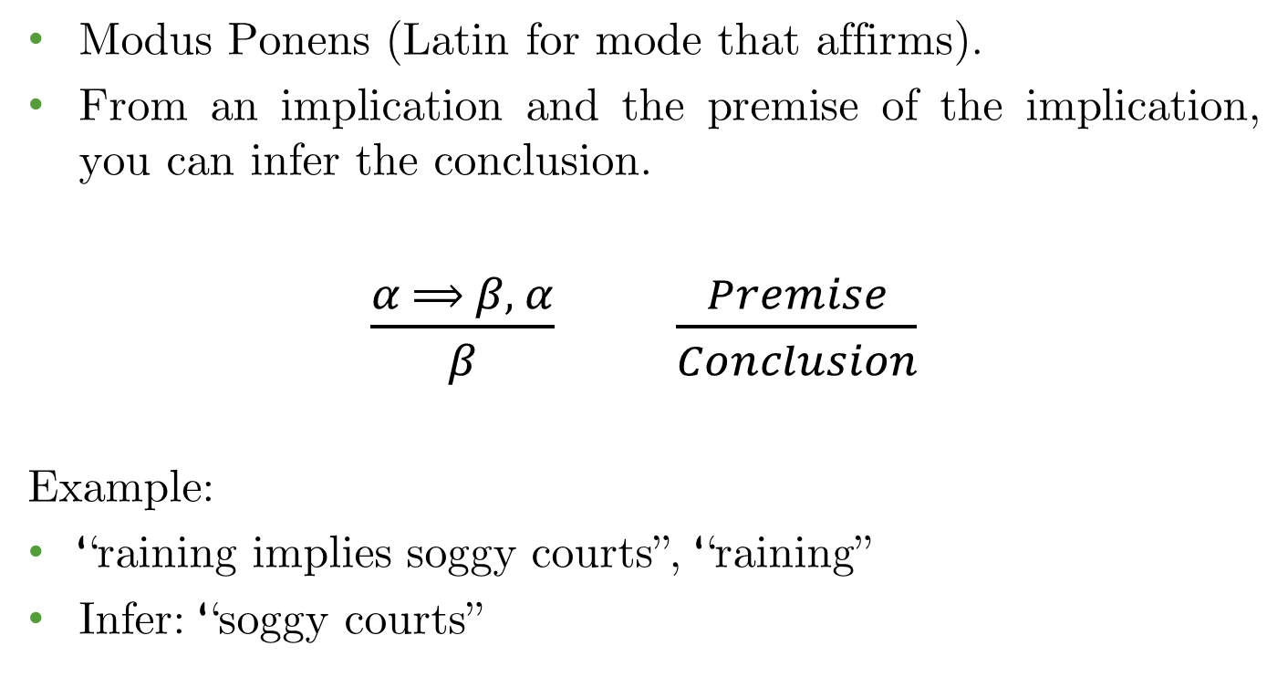
Inference Rules: Modus Ponens
Modus Ponens (Latin for mode that affirms).
From an implication and the premise of the implication, you can infer the conclusion.
$\frac{α ⟹ β, α}{β}$ $\frac{Premise}{Conclusion}$
Example:
“raining implies soggy courts”, “raining”
Infer: “soggy courts”

Slide 18
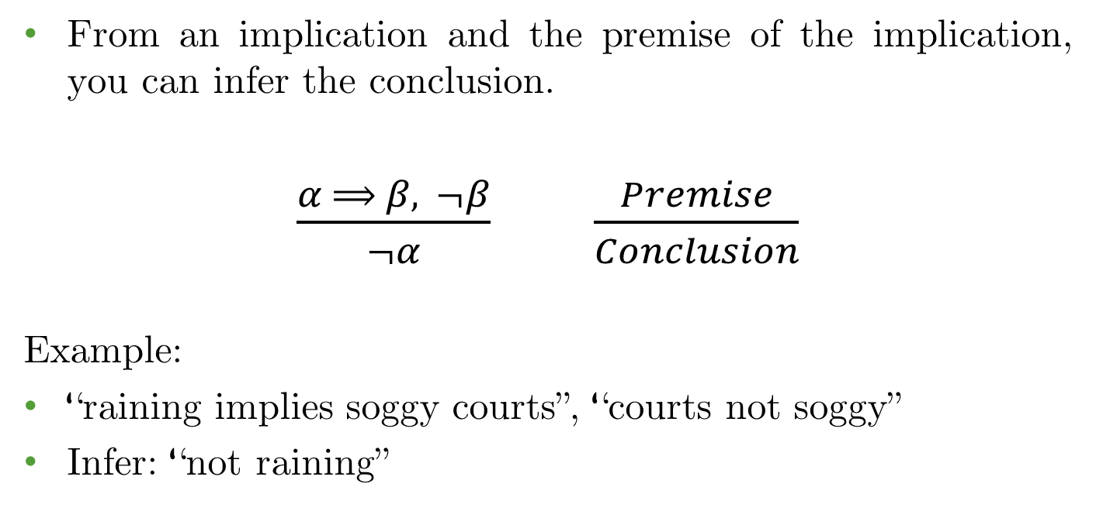
Inference Rules: Modus Tollens
From an implication and the premise of the implication, you can infer the conclusion.
$\frac{α ⟹ β, ¬β}{¬α}$ $\frac{Premise}{Conclusion}$
Example:
“raining implies soggy courts”, “courts not soggy”
Infer: “not raining”

Slide 19
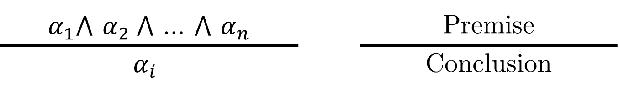
Inference Rules: AND Elimination
From a conjunction, you can infer any of the conjuncts.
$α_{1}$⋀ $α_{2}$⋀ … ⋀ $α_{n}$ |  | Premise
$$α_{i}$$ |  | Conclusion
Example:
Given, A ⋀ B is true then we can conclude A is true.

Slide 20
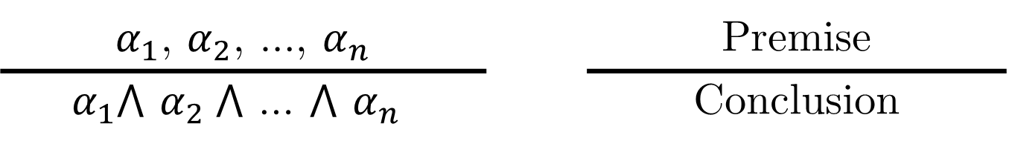
Inference Rules: AND Introduction
From true literals, you can infer their conjunction.
$α_{1}$, $α_{2}$, …, $α_{n}$ |  | Premise
$$α_{1}\text{⋀ }α_{2} \text{⋀ … ⋀ }α_{n}$$ |  | Conclusion
Example:
Given, A, B are true then we can conclude A ⋀ B is true.

Slide 21
Inference Rules: Double Negation
We can eliminate double negations.
¬¬𝛼 |  | Premise
𝛼 |  | Conclusion
Example:
Given, ¬¬A is true then we can conclude A is true.

Slide 22
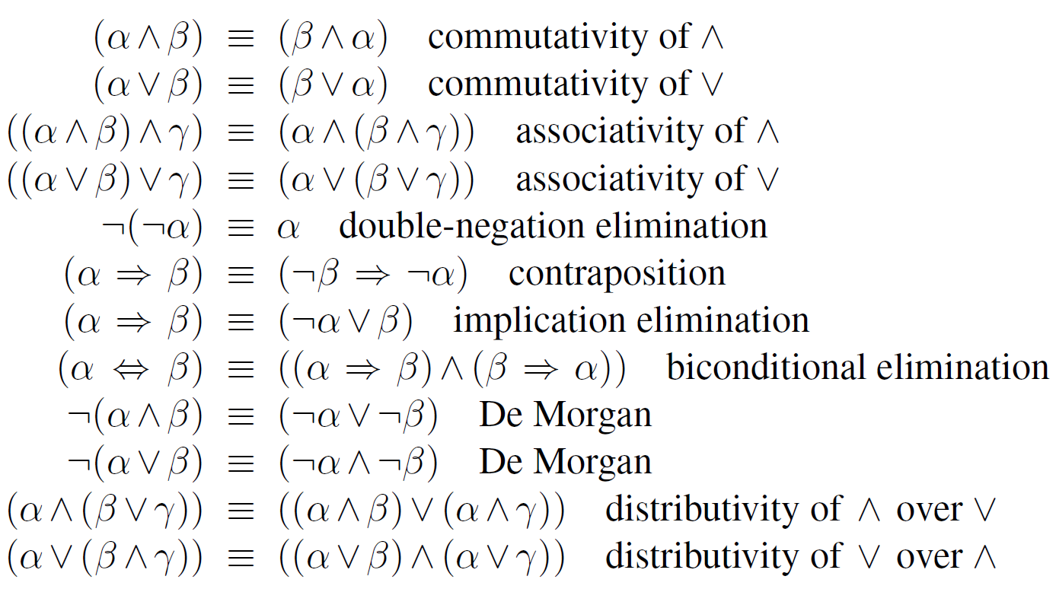
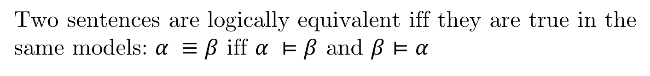
Inference Rules: Logical Equivalences
Two sentences are logically equivalent iff they are true in the same models: $α ≡β$ iff $α ⊨β$ and $β⊨α$

Slide 23
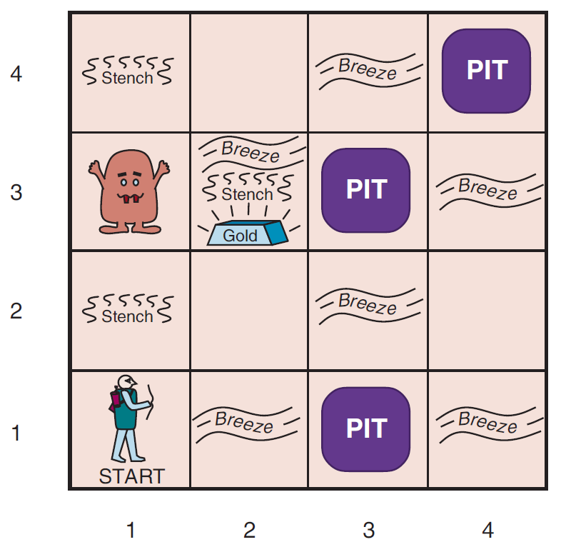
Example: The Wumpus World

Slide 24
Example
𝑃(𝑥, 𝑦) is true if there is a pit in [x,y]
𝑊(𝑥, 𝑦) is true if there is a Wumpus in [x,y], dead or alive
𝐵(𝑥, 𝑦) if agent perceives breeze in [x,y]
𝑆(𝑥, 𝑦) if agent perceives stench in [x,y]
KB: 𝛼= ¬P12 does KB ╞ 𝛼 ?
¬P11
B11 ⇔ (P12 ⋁ P21)
B21 ⇔ (P11 ⋁ P22 ⋁ P31)
¬B11
B21

Slide 25
Solution
KB: 𝛼= ¬P12 does KB ╞ 𝛼 ?
¬P11
B11 ⇔ (P12 ⋁ P21)
B21 ⇔ (P11 ⋁ P22 ⋁ P31)
¬B11
B21
(B11 ⇒ (P12 ⋁ P21) ⋀ (P12 ⋁ P21)) Biconditional (3)
P12 ⋁ P21 ⇒ B11 And elimination (6)
¬B11 ⇒ ¬(P12 ⋁ P21) Contraposition (7)
¬(P12 ⋁ P21) Modus Ponens (8, 4)
¬P12 ⋀ ¬P21 De Morgan (9)
¬P12 And elimination (10)

Slide 26
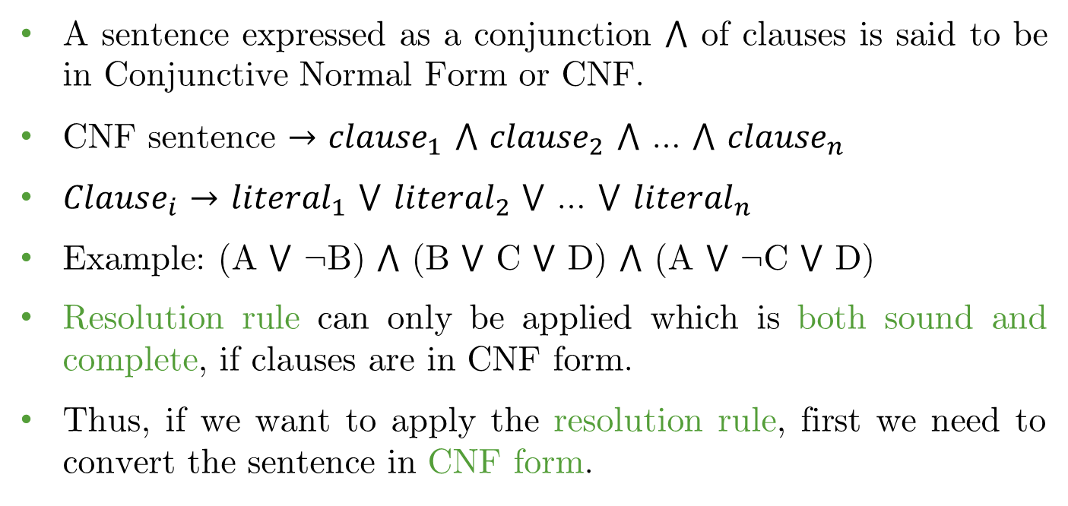
Conjunctive Normal Form (CNF)
A sentence expressed as a conjunction ⋀ of clauses is said to be in Conjunctive Normal Form or CNF.
CNF sentence $→$ $clause_{1}$ ⋀ $clause_{2}$ ⋀ … ⋀ $clause_{n}$
$Clause_{i}$ $→$ $literal_{1}$ ⋁ $literal_{2}$ ⋁ … ⋁ $literal_{n}$
Example: (A ⋁ ¬B) ⋀ (B ⋁ C ⋁ D) ⋀ (A ⋁ ¬C ⋁ D)
Resolution rule can only be applied which is both sound and complete, if clauses are in CNF form.
Thus, if we want to apply the resolution rule, first we need to convert the sentence in CNF form.

Slide 27
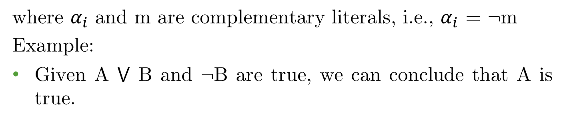
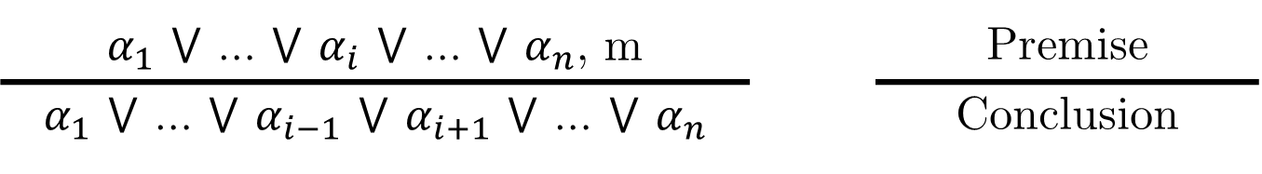
Unit Resolution
Unit Resolution inference rule:
$α_{1}$ ⋁ … ⋁ $α_{i}$ ⋁ … ⋁ $α_{n}$, m |  | Premise
$α_{1}$ ⋁ … ⋁ $α_{i−1}$ ⋁ $α_{i+1}$ ⋁ … ⋁ $α_{n}$ |  | Conclusion
where $α_{i}$ and m are complementary literals, i.e., $α_{i}$ = ¬m
Example:
Given A ⋁ B and ¬B are true, we can conclude that A is true.

Slide 28
Unit Resolution
Unit Resolution inference rule:
P11 ⋁ P22 ⋁ P31, ¬P22
P11 ⋁ P31
If there is a pit in one of [1,1], [2,2] and [3,1], and it is not in [2,2], then it’s in [1,1] or [3,1].

Slide 29
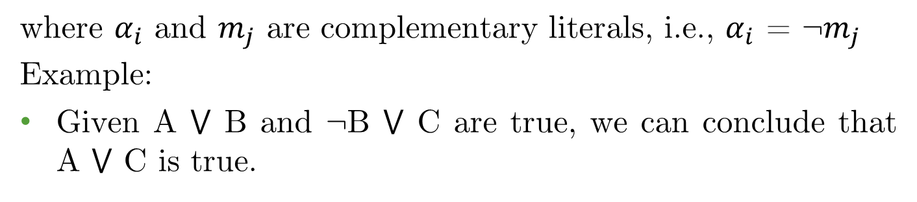
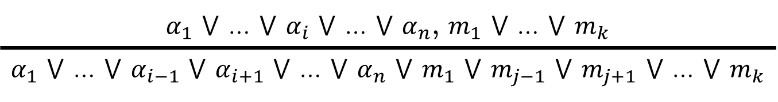
Resolution
Full Resolution inference rule:
$α_{1}$ ⋁ … ⋁ $α_{i}$ ⋁ … ⋁ $α_{n}$, $m_{1}$ ⋁ … ⋁ $m_{k}$
$α_{1}$ ⋁ … ⋁ $α_{i−1}$ ⋁ $α_{i+1}$ ⋁ … ⋁ $α_{n}$ ⋁ $m_{1}$ ⋁ $m_{j−1}$ ⋁ $m_{j+1}$ ⋁ … ⋁ $m_{k}$
where $α_{i}$ and $m_{j}$ are complementary literals, i.e., $α_{i}$ = ¬$m_{j}$
Example:
Given A ⋁ B and ¬B ⋁ C are true, we can conclude that A ⋁ C is true.

Slide 30
Knoweldge Representation & Reasoning
Factoring
Remove multiple copies of literals:
A ⋁ B , A ⋁ ¬B
A
Even though we obtain A ⋁ A which is reduced to just A by factoring.

Slide 31
Knoweldge Representation & Reasoning
Convert to CNF
Any knowledge base can be expressed as a conjunction of disjunctions (CNF), e.g., (A ⋁ ¬B) ⋀ (B ⋁ ¬C ⋁ ¬D).
Inference procedures based on resolution work by using the principle of proof by contradiction.
To show that KB╞ α we show that (KB ⋀ ¬α) is unsatisfiable. Thus, 𝛼 must be true.
The process:
Convert KB ⋀ ¬α to CNF.
Resolution Inference:
Proof by contradiction (easier and much faster)
Direct proof (sometimes difficult or impractical)

Slide 32
Knoweldge Representation & Reasoning
Example of Proof by Contradiction
KB = (B11 ⇔ (P12 ⋁ P21)) ⋀ ¬B11
𝛼 = ¬P12
First, convert (KB ⋀ ¬𝛼) to CNF.
We need to show that (KB ⋀ ¬α) is unsatisfiable.
Thus, 𝛼 must be true.

Slide 33
Example: Conversion to CNF
Example of Proof by Contradiction
First, convert B11 ⇔ (P12 ⋀ P21) to CNF.
(B11 ⇒ (P12 ⋁ P21)) ⋀ ((P12 ⋁ P21) ⇒ B11) (biconditional)
(¬B11 ⋁ P12 ⋁ P21) ⋀ (¬(P12 ⋁ P21) ⋁ B11) (equivalence)
(¬B11 ⋁ P12 ⋁ P21) ⋀ ((¬P12 ⋀ ¬P21) ⋁ B11) (De Morgan)
(¬B11 ⋁ P12 ⋁ P21) ⋀ (¬P12 ⋁ B11) ⋀ (¬P21 ⋁ B11) (distribution)
KB: (¬B11 ⋁ P12 ⋁ P21) ⋀ (¬P12 ⋁ B11) ⋀ (¬P21 ⋁ B11) ⋀ ¬B11
Thus, KB ⋀ ¬𝛼 becomes:
(¬B11 ⋁ P12 ⋁ P21) ⋀ (¬P12 ⋁ B11) ⋀ (¬P21 ⋁ B11) ⋀ ¬B11 ⋀ P12
Applying resolution on (¬P12 ⋁ B11) and P12 we get, B11
However, ¬B11 is also true. Contradiction.
Therefore, ¬𝛼 must be false, i.e., 𝛼 must be true.

Slide 34
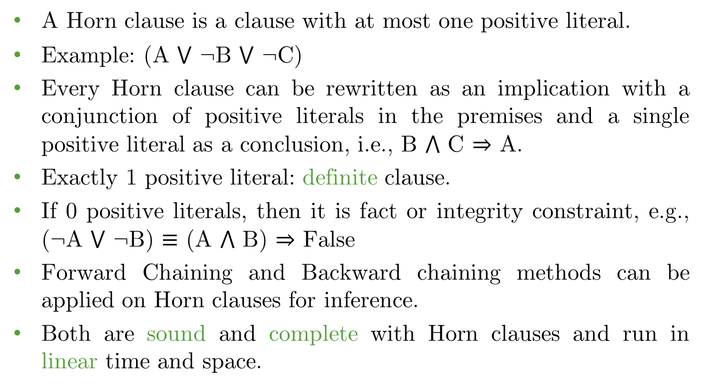
Horn Clauses
A Horn clause is a clause with at most one positive literal.
Example: (A ⋁ ¬B ⋁ ¬C)
Every Horn clause can be rewritten as an implication with a conjunction of positive literals in the premises and a single positive literal as a conclusion, i.e., B ⋀ C ⇒ A.
Exactly 1 positive literal: definite clause.
If 0 positive literals, then it is fact or integrity constraint, e.g., (¬A ⋁ ¬B) $≡$ (A ⋀ B) ⇒ False
Forward Chaining and Backward chaining methods can be applied on Horn clauses for inference.
Both are sound and complete with Horn clauses and run in linear time and space.

Slide 35
Horn Clauses
Horn form (special form of CNF) where disjunction (⋁) of literals of which at most one is positive.
KB is the conjunction (⋀) of Horn clauses.
Horn clause = propositional symbol; or
(conjunction (⋀) of symbols) ⇒ symbol
Modus Ponens is a natural way to make inference in Horn KBs.

Slide 36

Knoweldge Representation & Reasoning
Inference for Horn Clauses
Remove multiple copies of literals:
$α_{1}$, $α_{2}$,…, $α_{n}$, $α_{1}$ ⋀ … ⋀ $α_{n}$ ⇒ $β$
$$β$$
Successive application of modus ponens leads to algorithms that are sound and complete, and run in linear time.

Slide 37
Knoweldge Representation & Reasoning
Forward Chaining
KB | P ⇒ Q L ⋀ M ⇒ P B ⋀ L ⇒ M A ⋀ P ⇒ L A ⋀ B ⇒ L A B
 | 𝛼 = Q KB ╞ 𝛼 ?
Successively apply modus ponens until query is true.
Forward chaining is sound and complete for Horn KB.

Slide 38
Knoweldge Representation & Reasoning
Forward Chaining
KB:
P ⇒ Q L ⋀ M ⇒ P B ⋀ L ⇒ M A ⋀ P ⇒ L A ⋀ B ⇒ L A B | 8. | L | Modus Ponens (5, 6, 7)
 | 9. | M | Modus Ponens (3, 7, 8)
 | 10. | P | Modus Ponens (2, 8, 9)
 | 11. | Q | Modus Ponens (1, 10)

Slide 39
Knoweldge Representation & Reasoning
Backward Chaining
Forward chaining problem: can generate a lot of irrelevant conclusions.
Backward chaining: Work backwards from goal to premises.
Find all implications of the form (…) ⇒ query.
Prove all the premises of one of these implications.
Avoid loops: check if new subgoal is already on the goal stack
Avoid repeated work: check if new subgoal
Has already been proved true, or
Has already failed.

Slide 40
Knoweldge Representation & Reasoning
Backward Chaining
KB:
P ⇒ Q L ⋀ M ⇒ P B ⋀ L ⇒ M A ⋀ P ⇒ L A ⋀ B ⇒ L A B | 8. | Q | Goal | Prove Q.
 | 9. | P | Subgoal(1,8) | To prove Q, we need to prove P.
 | 10. | L ∧ M | Subgoal(2,9) | To prove P, we need to prove L and M.
 | 11. | L | Subgoal(10) | To prove L
 | 12. | A ∧ B | Subgoal(5,11) | We need to prove A ⋀ B
 | 13. | A | True(6) | We already know A and
 | 14. | B | True(7) | B from the facts.
 | 15. | L | True(5,13,14) | Thus, L is proven.
 | 16. | M | True(14,15) | Since both B and L is true.
 | 17. | P | True(15,16) | Since both L and M are true, P is true.
 | 18. | Q | True(1,17) | Since P is true, Q is true.

Slide 41
Forward vs. Backward Chaining
FC is data-driven
Automatic, unconscious processing
e.g., object recognition, routine decisions
May do lots of work that is irrelevant to the goal
BC is goal-driven, appropriate for problem-solving
Where are my keys? How do I get to my next class?
Complexity of BC can be much less than linear in the size of the KB

Slide 42
Common Inference Rules
Rule Names | Premise | Conclusion
Modus Ponens | A ⇒ B, A | B
Modus Tollens | A ⇒ B, ¬B | ¬A
And Elimination | A ⋀ B | A, B
And Introduction | A, B | A ⋀ B
Double Negation | ¬¬ A | A
Unit Resolution | A ⋁ B, ¬B | A
Resolution | A ⋁ B, ¬B ⋁ C | A ⋁ C
De Morgans | ¬ (A ⋁ B) | ¬ A ⋀ ¬ B
De Morgans | ¬ (A ⋀ B) | ¬ A ⋁ ¬ B
Contraposition | A ⇒ B | ¬B ⇒ ¬A
Equivalence | A ⇒ B | ¬A ⋁ B

Slide 43
Exercise
KB | Premise 1 | ¬(¬P ⋁ Q)
 | Premise 2 | ¬Z ⇒ ¬S
 | Premise 3 | (P ⋀ ¬Q) ⇒ S
 | Premise 4 | ¬Z ⋁ R
 | Query, 𝛼 = R Does KB ╞ 𝛼 ?
Apply inference rules to check if 𝛼 entails KB?

Slide 44
Exercise
KB | Premise 1 | ¬S11 ⇒ ¬W11 ⋀ ¬W12 ⋀ ¬ W21
 | Premise 2 | ¬S21 ⇒ ¬W11 ¬W21 ⋀ ¬W22 ⋀ ¬W31
 | Premise 3 | ¬S12 ⇒ ¬W11 ⋀ ¬W12 ⋀ ¬W22 ⋀ ¬W13
 | Premise 4 | S12 ⇒ W13 ⋁ W12 ⋁ W22 ⋁ W11
 | Prove that the Wumpus is in (1,3), i.e., query, 𝛼 = W13. Does KB ╞ 𝛼 ?
Apply inference rules to check if 𝛼 entails KB?

Slide 45
Summary
Logical agents apply inference to a knowledge base to derive new information and make decisions.
Basic concepts of logic:
Syntax: formal structure of sentences.
Semantics: truth of sentences w.r.t. models.
Entailment: necessary truth of one sentence given another.
Inference: deriving sentences from other sentences.
Soundness: derivations produce only entailed sentences.
Completeness: derivations can produce all entailed sentences.
Truth table method is sound and complete for propositional logic but cumbersome in most cases.
Application of inference rules is another alternative to perform entailment.

Slide 46
Reading
Chapter 07 of the textbook
Pages: 235 - 250

